Slide 1
Materialized View

Slide 2

The problem
You always design your Data Model for writing not reading
This lead a problem in Query Performance.

Slide 3
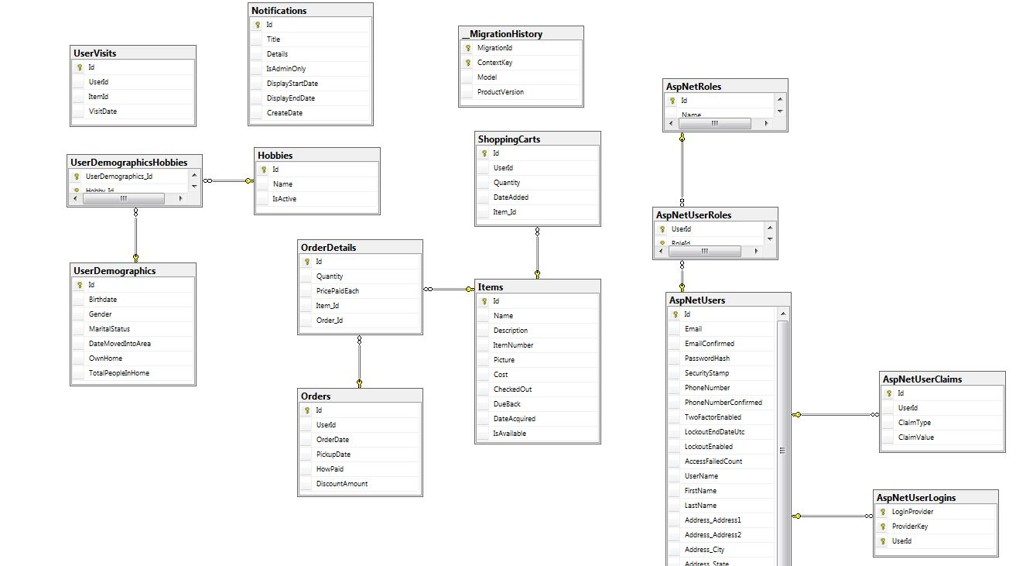
Example 1
Ex: Normalize data to multiple entities (Customers, Products, Orders, OrderDetails,….. etc) then you need to run a query to compare all the previous years revenue.

Slide 4
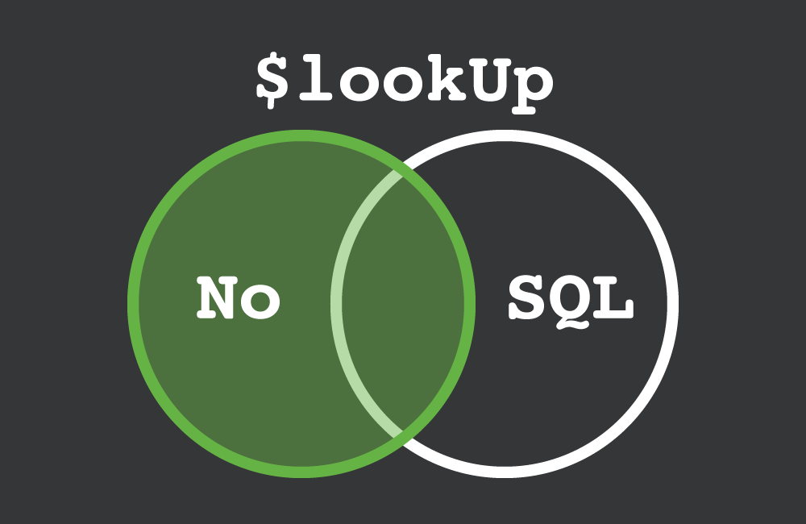
Example 2
Ex2: you write your data in NoSQL DB but you need to run a query that join between entities.

Slide 5
Solution
Materialized View

Slide 6
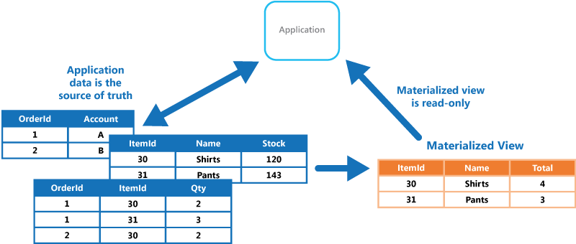
Materialized View
Generate, in advance, a view that materializes the data in a format suited to the required results set.
A materialized view can even be optimized for just a single query.
It can be entirely rebuilt from the source data stores.

Slide 7




Materialized View
Supported in different Data Engines
Or you can simply create a function to generate it and store the result on a table or collection.

Slide 8
Considerations
Automatic Update
Can affect writing performance
Event Sourcing
Strong consistency
Scheduled Update
Supported by some of Engines
use scheduled task to regenerate the view.
Eventual Consistency
Materialized Views are necessary

Slide 9
When to use
Query is Complex
Improve query performance
Bridging different data stores
Microservices
Security or privacy

Slide 10
When not to use
data is simple
Consistency is a high priority
Accessed without using a view

Slide 11
Demo

